Slide 1
Data Structures
and
Algorithms
BINARY TREES & BINARY SEARCH TREES
CSCI 237 – Fall 2019

Slide 2
BST – Binary Search TREE
Many applications require a dynamic set that support only the ADT operations SEARCH, INSERT, DELETE

Slide 3
Binary tree
General Tree Binary Tree
ROOT
EDGE
EDGE
PARENT
NODE
PARENT
NODE
CHILDREN
CHILDREN
LEAF
LEAF

Slide 4
Ordered and unordered tree
A tree is ORDERED if the child nodes are considered to be a SEQUENCE
A tree is UNORDERED if the child nodes are considered to be a SET (or a BAG)

Slide 5
Binary tree
An ORDERED general tree with 2 children is a Binary Tree
The children are denoted LEFT & RIGHT

Slide 6
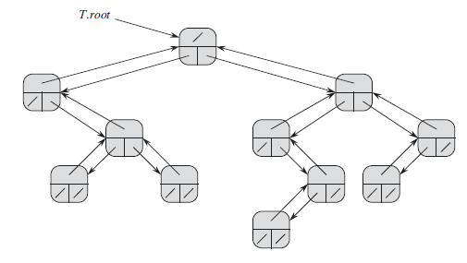
BINARY TREE
The representation of a binary tree T . Each node x has the attributes x.p (top), x.left (lower left), and x.right (lower right). The key attributes are not shown.

Slide 7
BINARY TREE
Draw the binary tree rooted at index 6 that is represented by the following attributes:
index key left right
1 12 7 3
2 15 8 NIL
3 4 NIL NIL
4 9 10 2
5 2 NIL NIL
6 18 1 4
7 7 NIL NIL
8 14 9 NIL
9 21 NIL NIL
10 5 5 NIL
6 / 18
1 / 12
4 / 9
7/ 7
3/ 4
10 /12
2 /15
5 /2
8 /14
1 / 12

Slide 8
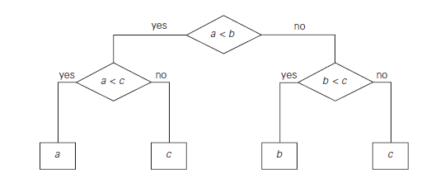
BINARY TREE
Use of Binary Tree as Decision Tree to Finding minimum of three numbers
a = 6, b = 8, c = 5

Slide 9
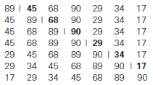
BINARY TREE
Quick note on Insertion Sort

Slide 10
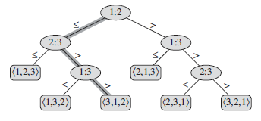
BINARY TREE
Use of Binary Tree as Decision Tree for Insertion Sort operating on three elements
a = 6, b = 8, c = 5, where a, b, and c are labeled as 1, 2 and 3, respectively in the figure below.

Slide 11
BINARY TREE CONSTRUCTION & TRAVERSAL
Given an array of elements, our task is to construct a complete binary tree from this array in level order fashion. That is, elements from left to right in the array will be filled in the tree level-wise, starting from level 0.
Input : arr[] = {1, 2, 3, 4, 5, 6}
Output : Root of the following tree
1
/ \
2 3
/ \ /
4 5 6
Input: arr[] = {1, 2, 3, 4, 5, 6, 6, 6, 6, 6}
Output: Root of the following tree
1
/ \
2 3
/ \ / \
4 5 6 6
/ \ /
6 6 6

Slide 12
Binary Tree – Binary Search TREE
For the set of {1, 4, 5, 10, 16, 17, 21} of keys, draw BTs of height 2, 3, 4, 5, 6.
Height of 2
1
4 5
10 16 17 21

Slide 13
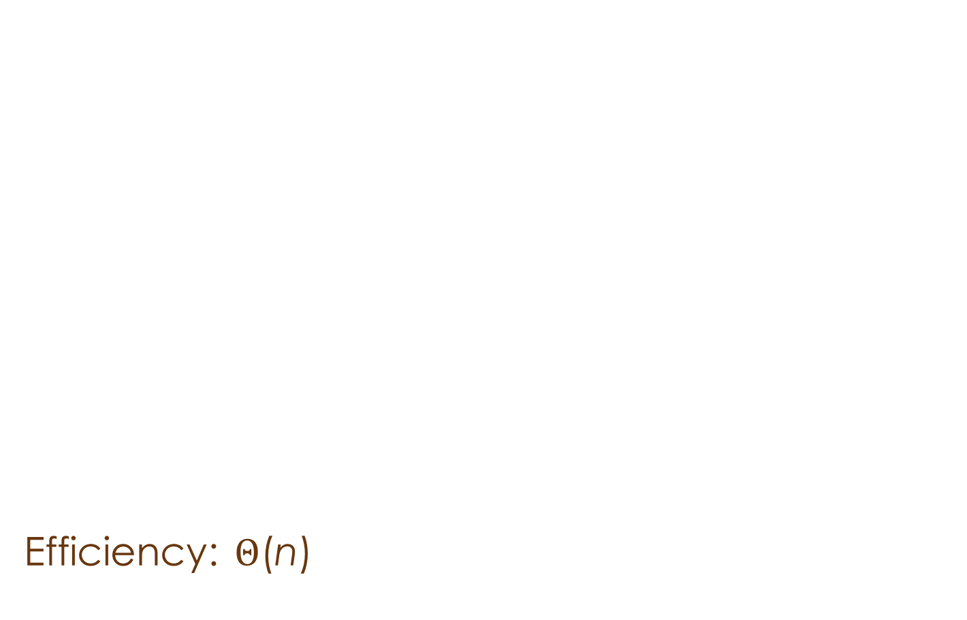
Binary Tree TRAVERSAL Algorithms
Binary tree is a divide-and-conquer ready structure!
Classic traversals are (preorder, inorder, postorder)
Preorder: root, left, right
Inorder: left, root, right
Postorder: left, right, root
Efficiency: $Θ$(n)
a
a
c
b
c
b
d
e
d
e

Slide 14



Binary tree traversal example
A
Pr: R, $l$, $r$
A
B
D
G
E
C
F
In: $l$,R, $r$
D
G
B
E
A
F
C
Po: $l$, $r,$R
G
D
E
B
F
C
A
B
C
D
E
F
G

Slide 15
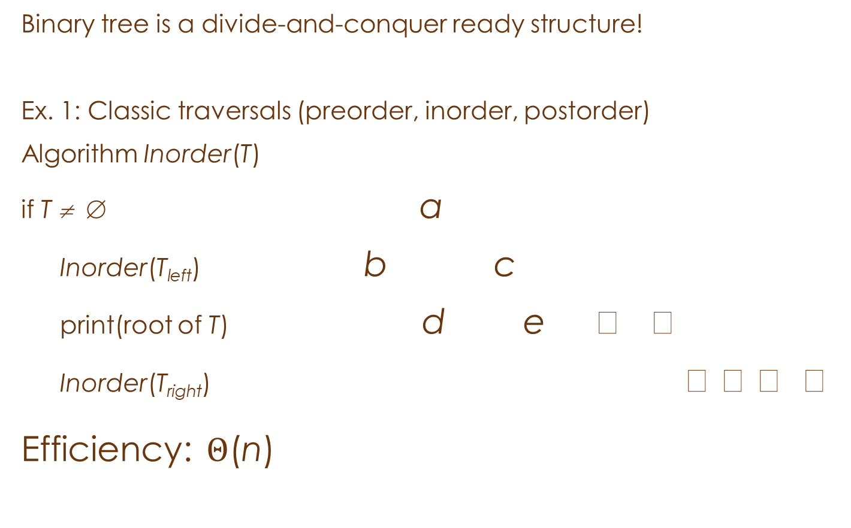
Binary Tree Algorithms
Binary tree is a divide-and-conquer ready structure!
Ex. 1: Classic traversals (preorder, inorder, postorder)
Algorithm Inorder(T)
if T ≠ ∅ a
Inorder(T_{left}) b c
print(root of T) d e  
Inorder(T_{right})    
Efficiency: $Θ$(n)
a
b
c
d
e

Slide 16
BINARY TREE CONSTRUCTION & TRAVERSAL
1) Draw a BT with 10 nodes labeled 0 – 9 in such a way that the inorder and postorder traversals yield the following lists:
Io: 9 3 1 0 4 2 7 6 8 5 Po: 9 1 4 0 3 6 7 5 8 2
2
2
5
8
0
3
4
6
0
5
3
4
7
8
6
7
9
1
9
1

Slide 17
BINARY TREE CONSTRUCTION & TRAVERSAL
2) Traverse the BT InOrder, PostOrder and PreOrder
A
B
C
D
E
F
G

Slide 18
Complete Binary tree
A complete binary tree is a binary tree whose all levels except the last level are completely filled and all the leaves in the last level are all to the left side.

Slide 19
Use of binary tree
Presenting an arithmetic expression:
(3+5^2)*(2+3/5)
What order of traversal yields the
original expression?
Leaves = operands (constants/variables)
Non-leaf nodes = operators
*
+
+
3
^
2
/
5
2
3
5

Slide 20
Example of BT Application
Used in most compilers
No parenthesis need – use tree structure
Can speed up calculations e.g. replace / node with C/D if C and D are known
Example Arithmetic Expression: A + (B * (C / D) )
Leaves = operands (constants/variables)
Non-leaf nodes = operators
+
A
*
B
/
Postorder: Children first, then Root : A B C D / * +
Preorder: Root, then Children : + A * B / C D
Inorder: Left child, Root, Right child: A + B * C / D
c
D

Slide 21
Example of BT Application
Example Arithmetic Expression: 2 x 4² + 5² / (26-1)
Leaves = operands (constants/variables)
Non-leaf nodes = operators
+
/
x
^
-
2
^
5
2
26
1
4
2
Postorder: Children first, then Root :
Preorder: Root, then Children :
Inorder: Left child, Root, Right child: 2x4^2+5^2/26-1

Slide 22
Binary Tree Algorithms (cont.)
Ex. 2: Computing the height of a binary tree
h(T) = max{h(T_{L}), h(T_{R})} + 1 if T ≠ ∅ and h(∅) = -1
Efficiency: Θ(n)

Slide 23
Depth of BT
Depth 0: N = 1 = 2⁰ nodes
Depth 1: N = 2 to 3 nodes
= 2¹ to 2¹⁺¹-1 nodes
At depth d, N = ?
Given N nodes, what is the minimum depth of a binary tree?
At depth d, N = 2^{d} to 2^{d+1}-1 nodes (a full tree)
So, minimum depth d is: log N ≤ d ≤ log(N+1)-1 or Θ(log N)
Given N nodes, what is the maximum depth of a binary tree?

Slide 24
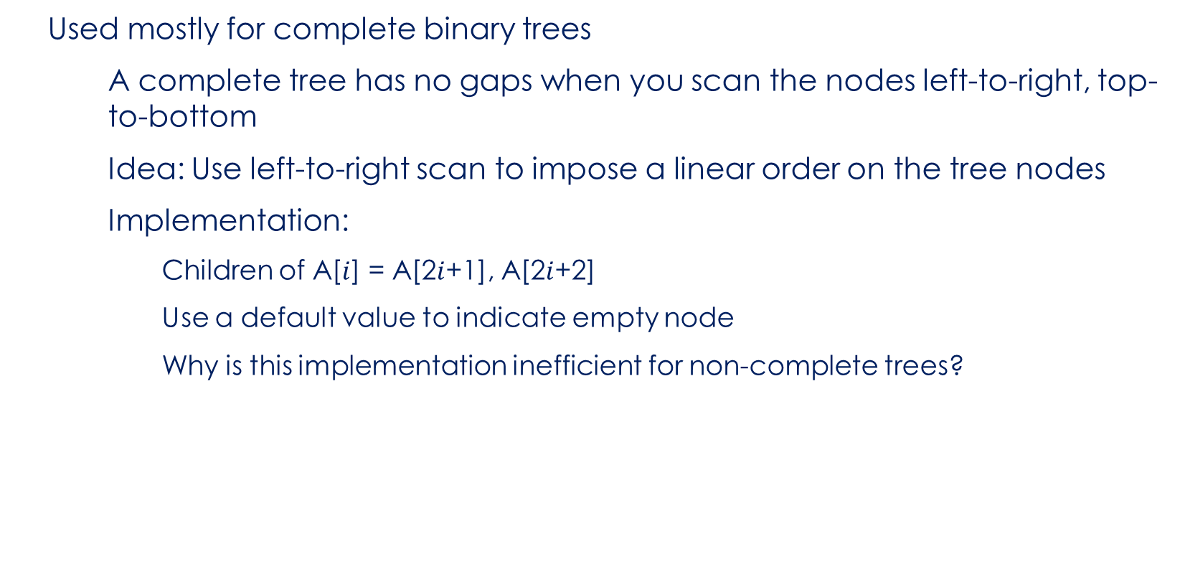
Array Implementation of Binary Trees
Used mostly for complete binary trees
A complete tree has no gaps when you scan the nodes left-to-right, top-to-bottom
Idea: Use left-to-right scan to impose a linear order on the tree nodes
Implementation:
Children of A[$i$] = A[2$i$+1], A[2$i$+2]
Use a default value to indicate empty node
Why is this implementation inefficient for non-complete trees?
0 | 1 | 2 | 3 | 4 | 5 | 6 | …
14 | 15 | 97 | 5 | 24 | 3 | 18 | …

Slide 25
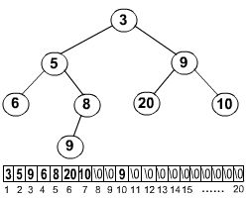
Array Implementation of Binary Trees

Slide 26
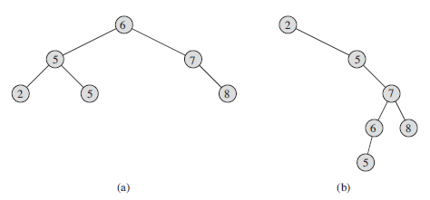
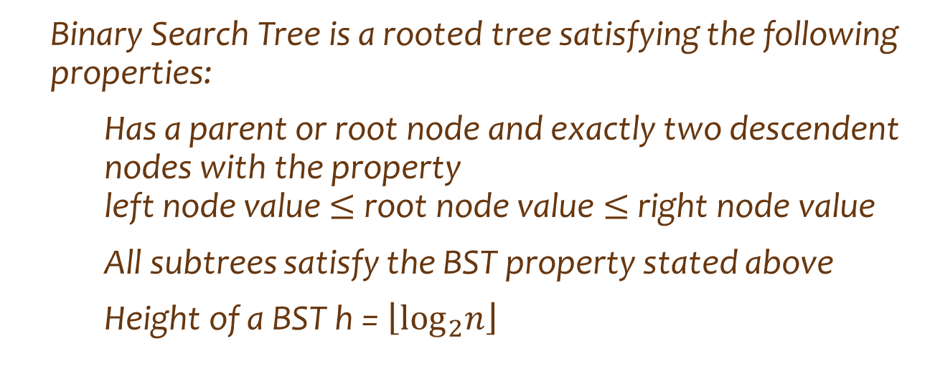


Binary Search TREE
Binary Search Tree is a rooted tree satisfying the following properties:
Has a parent or root node and exactly two descendent nodes with the property left node value $≤$ root node value $≤$ right node value
All subtrees satisfy the BST property stated above
Height of a BST h = $\left\lfloor \log_{2}n\right\rfloor$
$x$ > all values in L
$x$ < all values in R
$$x$$
BST
L
R

Slide 27

Binary Search TREE
Is the following a BST?
45
22 77
11 30 90
15 25 88
BST Requirement:
Has a parent or root node and exactly two descendent nodes with the property left node value $≤$ root node value $≤$ right node value
All subtrees satisfy the BST property stated above

Slide 28
Application of BST
Operations on Binary Search Trees
Main Operations:
FindMin(BinaryNode T)
FindMax(BinaryNode T)
Find(Comparable X, BinaryNode T)
Insert(Comparable X, BinaryNode T)
Remove(Comparable X, BinaryNode T)
Where T is the root node of the inverted tree.

Slide 29
Application of BST
How would you implement these?
Exercise: How does Find(X,T) work?
For example Find (96,T)
9
5
94
Pseudocode:
How does Find(X,T) work?
If T null, return null
If X < T.Element
return Find(X,T.left)
else if X > T.Element
return Find(X,T.right)
else return T //Found!
10
97
96
99

Slide 30
Application of BST
How would you implement these?
How insert X,T) works?
For example Insert(95,T)
9
5
94
Pseudocode:
Insert(Comparable X, BinaryNode T)
If T null, Insert X at T
else if X < T.Element
T.left = Insert(X,T.left)
else if X > T.Element
T.right = Insert(X,T.right
Return T
10
97
96
99

Slide 31
Application of BST
How would you implement these?
For example Insert(4,T)
6
3
7
Pseudocode:
Insert(Comparable X, BinaryNode T)
If T null, Insert X at T
else if X < T.Element
T.left = Insert(X,T.left)
else if X > T.Element
T.right = Insert(X,T.right
Return T
2
5
18
99

Slide 32
Binary Search TREE
For the set of {11, 4, 5, 10, 16, 17, 21} of keys, draw BST
Height of 2 Tallest BST (Can you think of it?)
11
5 17
4 10 16 21
Height of 3
5
4 11
10 17
16 21

Slide 33
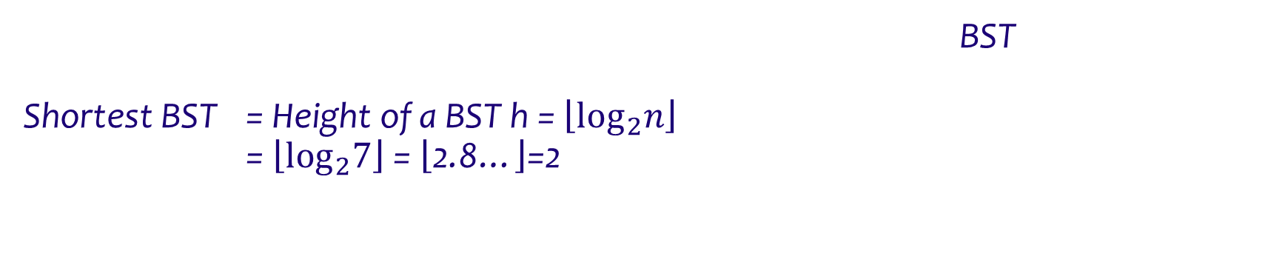
Binary Search TREE
For the set of {21, 4, 16, 10, 5, 17, 11} of keys, draw Shortest BST
Shortest BST = Height of a BST h = $\left\lfloor \log_{2}n\right\rfloor$
= $\left\lfloor \log_{2}7\right\rfloor$ = $\left\lfloor \text{2.8…}\right\rfloor$=2
11
5 17
4 10 16 21

Slide 34
Binary Search TREE
OPTIMAL BINARY SEARCH TREE
Organize a BST so as to minimize the number of nodes visited in all searches
A B
B A C
C D
D
Consider four keys A, B, C, and D to be searched for with probabilities 0.1, 0.2, 0.4,
and 0.3, respectively
Cost of 3-high tree = 0.1 * 1+0.2 * 2+0.4 * 3+0.3 * 4 = 2.9
Cost of 2-high tree = 0.1 * 2 + 0.2 * 1+ 0.4 * 2 + 0.3 * 3= 2.1.

Slide 35











Binary Search TREE
Represent the given BST, in figure, by an appropriate data structure.
$$k_{2}$$
$$k_{1}$$
$$k_{5}$$
$$d_{0}$$
$$d_{1}$$
$$k_{4}$$
$$d_{5}$$
$$k_{3}$$
$$d_{4}$$
$$d_{2}$$
$$d_{3}$$
$$k_{2}$$ | $$k_{1}$$ | $$k_{5}$$ | $$d_{0}$$ | $$d_{1}$$ | $$k_{4}$$ | $$d_{5}$$ | $$null$$ | $$null$$ | $$null$$ | $$null$$ | $$k_{3}$$ | $$d_{4}$$
0 | 1 | 2 | 3 | 4 | 5 | 6 | 7 | 8 | 9 | 10 | 11 | 12

Slide 36
Binary Search TREE
Suppose that we have numbers between 1 and 1000 in a binary search tree, and we want to search for the number 363.
Which of the following sequences could not be the sequence of nodes examined?
a. 2, 252, 401, 398, 330, 344, 397, 363.
b. 924, 220, 911, 244, 898, 258, 362, 363.
c. 925, 202, 911, 240, 912, 245, 363.
d. 2, 399, 387, 219, 266, 382, 381, 278, 363.
e. 935, 278, 347, 621, 299, 392, 358, 363.
For example let us identify the order of node search in (a).
When key < parent, search takes left branch,
when key > parent, search takes right branch, and
when key = parent search, search stops
Remember Left tree < root node < right tree
Key = 363
2 R 252 R 401 L 398 L 330 R 344 R 397 L 363
924 L 220 R 911 L 244 R 898 L 258 R 362 R 363
925 L 202 R 911 L 240 R 912 L 245 R 363.
2 R 399 L 387 L 219 R 266 R 382 L 381 L 278 R 363.
935 L 278 R 347 R 621 L 299 R 392 L 358 R 363.

Slide 37
Binary Search TREE
NEXT (as time permits):
Removing a node from BST
Balanced Search Trees
Heaps

